Slide 1
Ontology-based Information Extraction with a Cognitive Agent
Peter Lindes¹, Deryle Lonsdale, David Embley
Brigham Young University
AAAI 2015
¹Now at University of Michigan
© 2015 Peter Lindes
Notes:
Hello, I am Peter Lindes. I am presenting work I did last year as my master’s thesis in Linguistics at Brigham Young University using the Soar cognitive architecture to do information extraction.
I’d like to thank Deryle Lonsdale and David Embley, my two professors there who helped a great deal on this project.
Now I am a PhD student with John Laird at the University of Michigan, to whom I am grateful for being able to come to this conference.

Slide 2
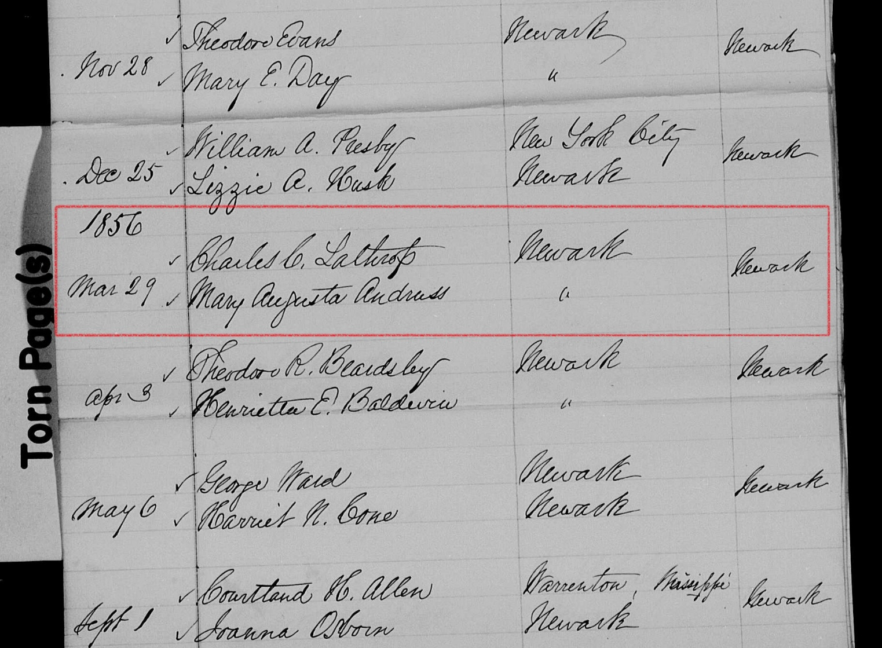
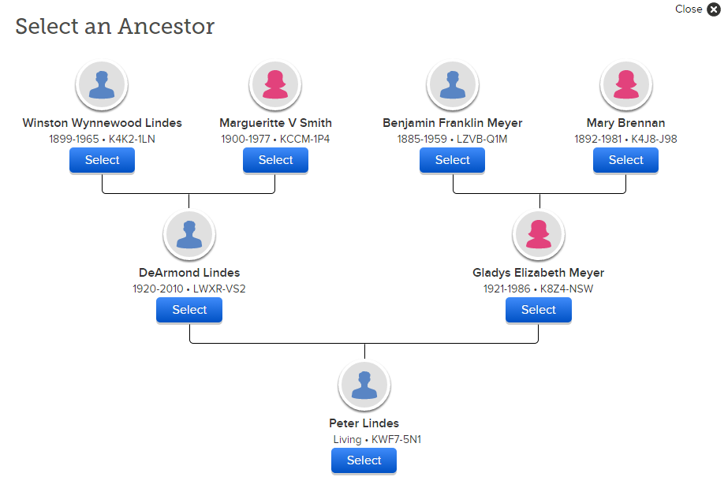
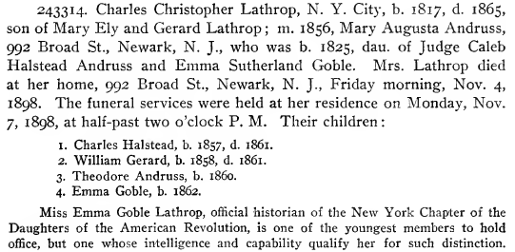
The Problem
Notes:
The particular information extraction problem we addressed was extracting genealogy information from family history books.
Here you see part of a page from a book called “The Ely Ancestry.” We want to extract names, dates, and family relationships from this kind of text.
Genealogy research is a big industry and represents a large portion of Internet traffic. I entered Charles Christopher Lathrop, the first name here, along with his dates and the name of his wife into the Family Search web site and pushed the search button. Immediately I got a link to this: an image showing their marriage in an official records book.
We would like to have searches of this kind link directly to pages from the hundreds of thousands of scanned books on line.
From this information we can build family trees like this one for me.

Slide 3
Goals and Strategies
OntoSoar project goals
  Extract genealogy facts from family history books
  Project extracted information onto a conceptual model to populate a searchable database
Strategies
  Use ideas from Embodied Construction Grammar
  Use the Soar cognitive architecture
  Integrate several levels of knowledge
Long term goals
  Build computational models of human language processing
  Apply these models to real-world applications
Notes:
This project is called OntoSoar. We’ll see where that name comes from a little later. The goal was to extract this information and project it onto an ontology so as to populate a searchable database.
We have done this by using ideas from the Embodied Construction Grammar developed at UC Berkeley and the Soar cognitive architecture, and by integrating several levels of linguistic knowledge.
I hope to use this experience to lead into research on building useful computational models of human language understanding.

Slide 4
Example 1
Notes:
In more detail, we want to analyze text like this to find names of people (shown in green), dates (in blue), relations between names and dates (in yellow), and relations between people ( in pink). Finding these depends on understanding the linguistic structures in the text.
Once we have found this information, we want to use it to populate an ontology …

Slide 5
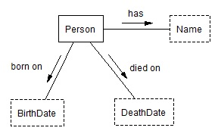
A Simple Ontology
has
Charles Christopher Lathrop
born on
died on
1817
1865
Notes:
Here is a diagram of a simple ontology relating people to their names and dates. We can use the entities found in the text to populate it like this.

Slide 6
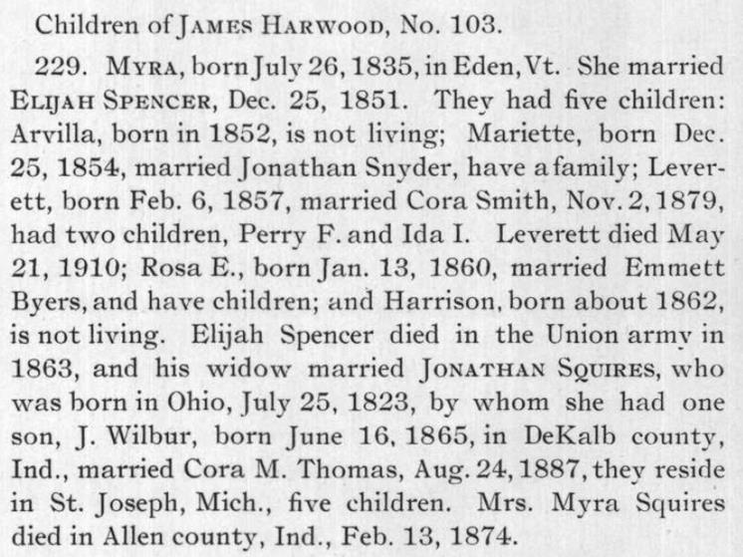
Example2
Notes:
Here is a much more challenging example. Highlighting just some of the facts, we see at the beginning a child named Myra Harwood being born in 1835. At the very end someone named Mrs. Myra Squires died in 1874. Are these the same person?
We can find the answer only through a chain of reasoning. Myra married Elijah Spencer. Elijah Spencer died. His widow, Myra, married Jonathan Squires and they had one son named J. Wilbur. Now we can deduce that Mrs. Myra Squires is indeed the same person, as well as a lot more about her life.

Slide 7
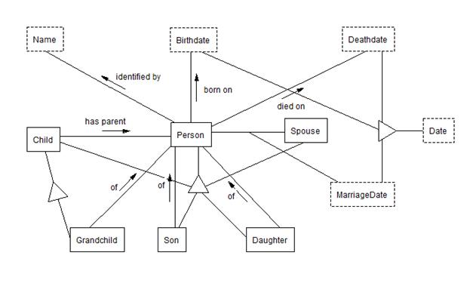
A More Complex Ontology
Myra Harwood
Feb. 13, 1874
Jonathan Squires
J. Wilbur Squires
Notes:
Here is an ontology that included family relationships.
We can populate it with the information on the child of Myra and her second husband and how they relate to each other.

Slide 8
The Solution
Thus, intelligence is the ability to bring to bear all the knowledge that one has in service of one’s goals.
Newell (1990), p. 90
Conceptual Models
World Knowledge
Pragmatics
Semantics
Syntax
Text Analysis
Page Layout *
Notes:
Allen Newell defined intelligence as “the ability to bring to bear all the knowledge that one has …” OntoSoar successfully integrates knowledge at all the levels shown here, except for Page Layout.
This is done using the following structure: …

Slide 9
OntoSoar Architecture
Notes:
Here is a block diagram of the OntoSoar system. It shows components developed from scratch for OntoSoar in blue, and elements using pre-existing code in yellow.
The Segmenter does textual processing and breaks the text up into segments which are basically clauses. Then we have used the Link Grammar parser developed at CMU to do syntactic analysis. The output of the parser goes into Soar.
The primary contribution is in the Semantic Analyzer made up of the three blue elements on the right. These are all implemented using the Soar cognitive architecture, and using models inspired by the Embodied Construction Grammar developed at UC Berkeley.
The OntoES Tool Set provides tools for designing and using ontologies, and combining this with Soar gives the name OntoSoar.

Slide 10
Construction Grammar
Notes:
Briefly, Construction Grammar is based on the idea of “constructions,” which are pairings of form with meaning.
Here are two examples where the form pole is represented by blue rectangles and the meaning pole by green ovals. When the system finds a match between its input and the form pole of a construction, it then constructs the corresponding meaning elements.
For example, …

Slide 11
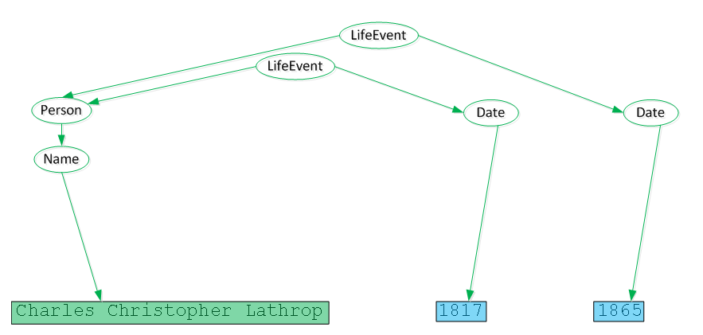
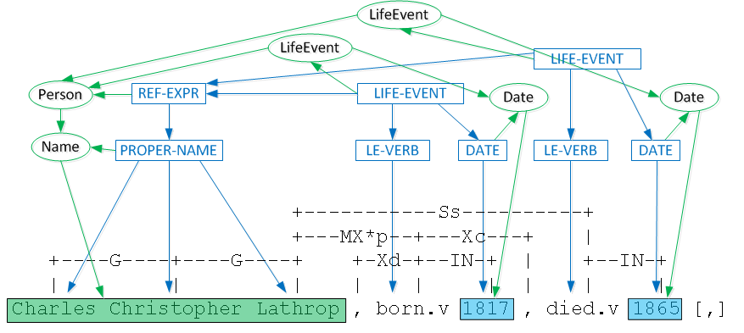
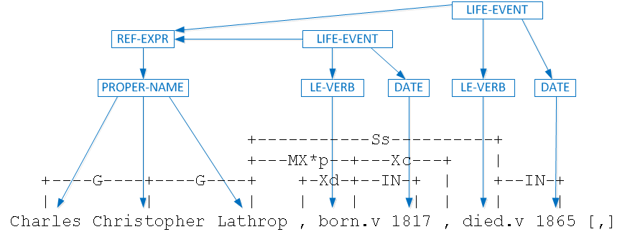
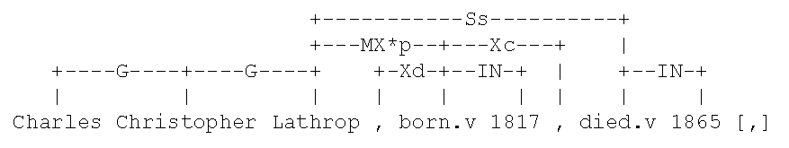
Applying Constructions
Charles Christopher Lathrop, N. Y. City, b. 1817, d. 1865, son of Mary Ely and Gerard Lathrop ;
Notes:
… consider the first clause in our first example text. The input text at the top is parsed by the Link Grammar parser, to produce a syntactic structure called a linkage. Here we see just the first half. The form patterns of several constructions match the input, and then the meaning elements are constructed. Once there, the syntactic elements can be dropped.

Slide 12
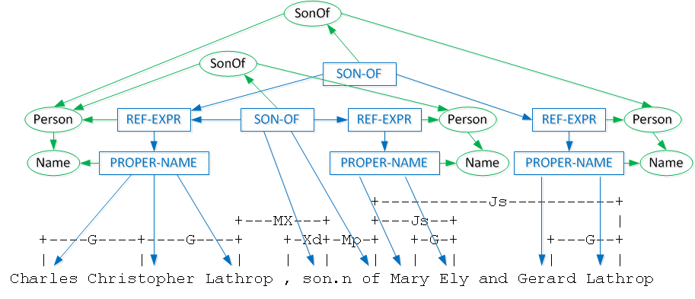
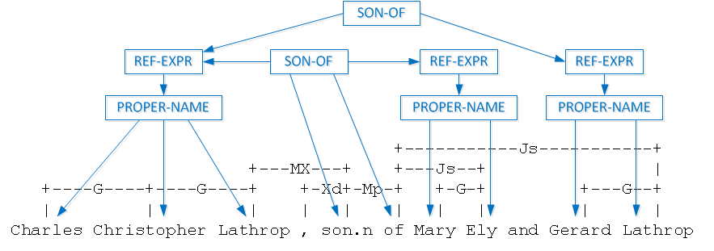
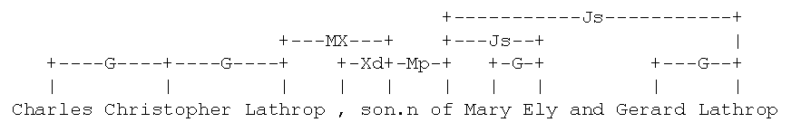
… More Constructions
Charles Christopher Lathrop, N. Y. City, b. 1817, d. 1865, son of Mary Ely and Gerard Lathrop ;
Notes:
A similar process proceeds for the second part of the clause.
Now we can use these meaning elements …

Slide 13
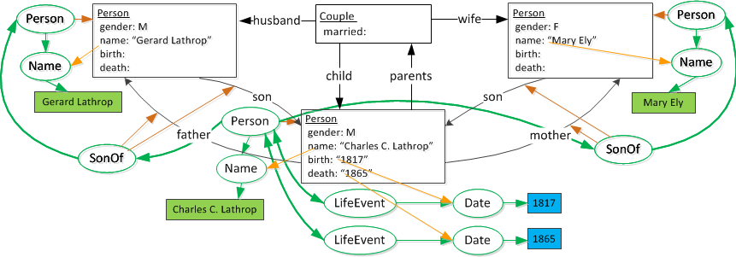
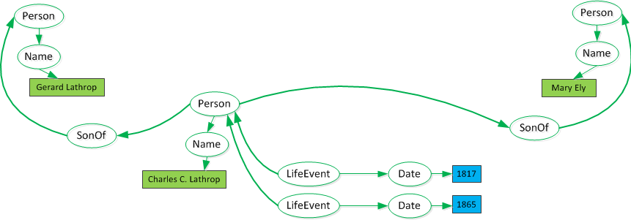
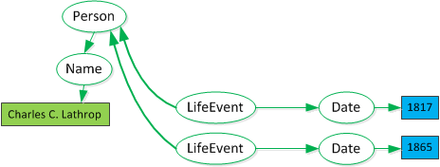
Building Knowledge
Charles Christopher Lathrop, N. Y. City, b. 1817, d. 1865, son of Mary Ely and Gerard Lathrop ;
Notes:
… to build a knowledge structure using inference rules.
Once this is built, it stands alone.

Slide 14
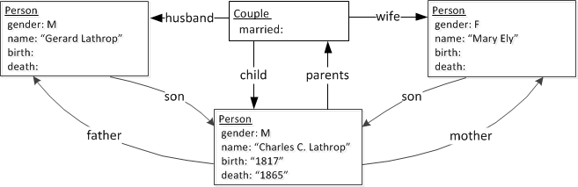
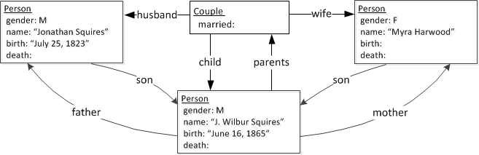
Knowledge Structures Compared
Charles Christopher Lathrop, N. Y. City, b. 1817, d. 1865, son of Mary Ely and Gerard Lathrop ;
… his widow married JONATHAN SQUIRES, who was born in Ohio, July 25, 1823, by whom she had one son, J. Wilbur, born June 16, 1865,
Notes:
Now let’s compare this result with the structure derived from our other example about Myra and Jon and their one son.
Here we see that the knowledge structures are exactly the same, while the linguistic forms the came from are very different. This shows the power of the current approach.
Within the scope of a master’s thesis, it was not possible to finish implementing all these ideas. Nevertheless, we can show some significant results …

Slide 15
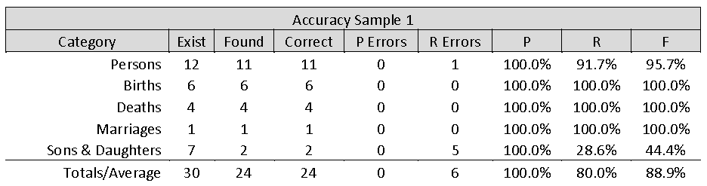
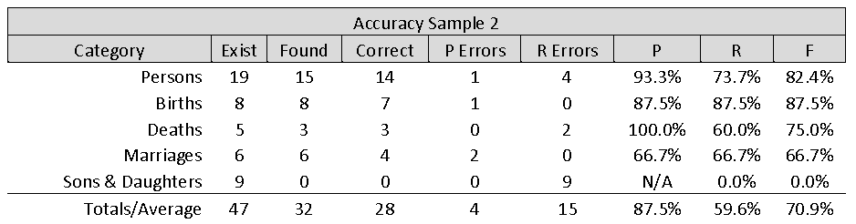
Results on Examples
Notes:
Here we have data on the two text examples we looked at earlier. We have measured both precision and recall for several different kinds of facts we were looking for. For the first example the precision is 100%, with the recall lower for Persons. Child relations had much lower recall because we had not yet implemented the construction for the phrase “Their children:” followed by a list of children. The children were found as persons, but not connected to their parents.
The second example uses much more challenging language, including a number of constructions we had not yet implemented. Thus both the precision and the recall are lower. However, we believe that the same semantic analysis approach can be expanded to find almost all these facts correctly.

Slide 16
Notes:
We did a more extensive study to evaluate the system on sample pages from twelve other books that we had never seen before. The first two sets of bars here are the same examples we have been talking about, and the rest are the other twelve samples. We only measured precision since we didn’t have the resources to annotate all these samples completely by hand.
Mainly we see here that there is a wide variation in the performance. When looking at the details, it becomes clear that the main thing the system lacks is a wide range of constructions to handle the variety of ways the same kinds of facts are expressed by different authors in English.

Slide 17
Results on The Ely Ancestry
a book of 830 pages, including our Example 1
Item Type | Instance Found
Persons | 16,848
Births | 8,609
Deaths | 2,406
Genders | 1,674
Couples | 3,343
Children | 3,049
Total | 35,929
Notes:
Our final evaluation was to run the entire 830 pages of the Ely Ancestry book, from which our first example came, through the system. It took several hours overnight to run the whole book, but as you can see if found tens of thousands of facts. Since we got high accuracy on selected samples from this book, we feel all these facts are at a pretty high accuracy rate, although we had no way to get a ground truth for the whole book.

Slide 18
Conclusions
It works! … and, it could work a lot better.
Contributions
Future Work
Produces usable genealogy data from scanned books
Does this using:
  Integration of several levels of knowledge
  An adaptation of Embodied Construction Grammar
  A cognitive architecture (Soar)
Integrate parsing with semantics
Develop a means to learn many new constructions
Adapt to varying book styles
Scale up to perform well on 100’s of thousands of books
Notes:
Our most important conclusion is that this system, which should be thought of as an early prototype, can in fact extract useful genealogical information from books of this type by integrating several levels of linguistic knowledge, adapting Embodied Construction Grammar to this task, and building on the Soar cognitive architecture as a base.
Future work should include a new parser that is integrated with the semantic analyzer, and making a system that, with some human input, can learn all the constructions it needs to adapt to a wide variety of linguistic expressions and styles from a variety of authors, and thus scale up to perform well on hundreds of thousands of different books.
Thank you!

